Slide 1
HONDA Supplier Collaboration
Jul.XX 2024
CSE
Confidential - DS Internal Information Sharing Purpose ONLY

Slide 2
Contents
1. Purpose of this document
2. HONDA Supplier Collaboration
3. Special license offering for HONDA Guest Engineer
4. SBO process
5. FAQ
6. Other
Confidential - DS Internal Information Sharing Purpose ONLY

Slide 3
1. Purpose of this document

Slide 4
Purpose of this document
Since HONDA’s 3DEXPERIENCE CATIA Go-Live in 2021, Supplier collaboration framework will be expanded into global finally (Japan,NAM,China, Thailand, India, Brazil etc…)
This document is created for DS internal information sharing purpose only and should not be shared with outside of DS.
We share our knowledge from Japan to help other GEOs to be prepared to better support HONDA and HONDA suppliers.
Confidential - DS Internal Information Sharing Purpose ONLY

Slide 5
2. HONDA Supplier Collaboration
Confidential - DS Internal Information Sharing Purpose ONLY

Slide 6
In this chapter you can see…
Fundamental knowledge about Honda supplier collaboration as below,
what is supplier collaboration(concept, scheme)
Where is license, how to use, and why
Confidential - DS Internal Information Sharing Purpose ONLY

Slide 7
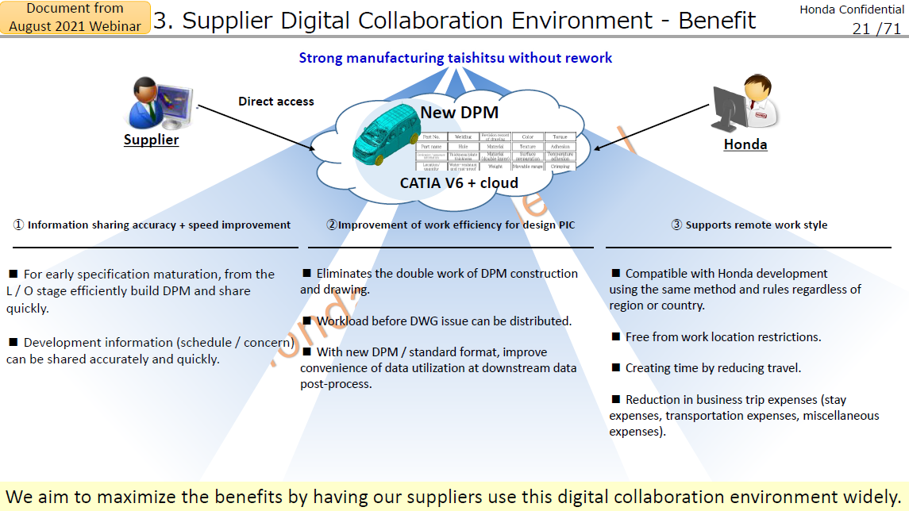
Concept
Confidential - DS Internal Information Sharing Purpose ONLY

Slide 8
Concept
HONDA Requirement
Solution
HONDA prepared MS Azure as “connection point”.
1. “Connection point” as “Supplier digital collaboration environment” for direct access.
DS proposed “Managed DSLS” to install license and it can be accessed by internet.
2. No specific VPN to connect HONDA environment and Supplier environment.
Same license in “Managed DSLS” can be used both for HONDA work and supplier own work
3. Suppliers can use licenses both for HONDA work and supplier own work.
The Product Type is “Shareable” to enable work in both environments.
Confidential - DS Internal Information Sharing Purpose ONLY

Slide 9









HONDA Work
Supplier X Work
Honda Supplier Collaboration Overview
HONDA Work Env.
Supplier is working for HONDA in HONDA’s virtual env.
Supplier Work Env.
Supplier is working for themselves in Supplier’s env.
HONDA allow direct access from Supplier to HONDA’s 3DEXPERIENCE platform remotely to collaborate for efficient product development with new development flow.
Supplier can use DS License for Supplier’s own work
with “PCS” purchased by Supplier.
Supplier
Premise
Client Machine (VDI) on MS Azure
Honda Motor
Premise (Japan)
Platform
User
(Supplier’s Employee)
Platform
Guest Engineer (Window person)
Max 1 per supplier
Data Base
Data Base
DS Managed DSLS
MES
Supplier’s
License Server
PCS
TAD
Honda
license
Server
PCS
Confidential - DS Internal Information Sharing Purpose ONLY

Slide 10
3. Special license offering for HONDA Guest Engineer
Confidential - DS Internal Information Sharing Purpose ONLY

Slide 11
In this chapter you can see…
Fundamental knowledge about Guest Engineer license offering as below,
License Type & Scheme
Pricing terms
Offering limitation
Amendment to MLA – Special terms appendix
Authorized supplier for guest engineer license
SBO Process
Confidential - DS Internal Information Sharing Purpose ONLY

Slide 12
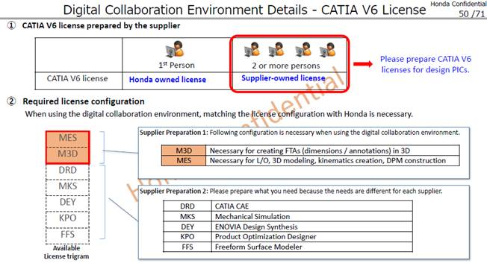
Honda Supplier collaboration Guest Engineer License
Honda shared document
 | For Guest Engineer (PIC, window person) 1 supplier Max 1 |  | For Supplier User
Usecase | Single country use | Multi country use
License program | 1)HONDA Designer PKG(MES+TAD+MMO+DEY+TEO+VRR+SUM+SFO) 2)HONDA 3DA PKG (MES+TAD)
Licensee | Local Honda Affiliates (only who defined in Exhibit F) | Only Honda Motor(Japan)
Available Offer | New Purchase only | New purchase and/or migration from HM purchased Designer PKG
Purchased by each supplier
Multi country use is available to purchase by only HM Japan
Confidential - DS Internal Information Sharing Purpose ONLY

Slide 13
Guest Engineer License(Single country use)
License program ：1)HONDA Designer PKG(MES+TAD+MMO+DEY+TEO+VRR+SUM+SFO)
2)HONDA 3DA PKG (MES+TAD)
Licensee ：each local Honda Affiliates (only who defined in Exhibit in contract)
Available QTY ：1 supplier Max1. cannot exceed 1 unless DS approval with writing (including e-mail)
Price(PLC/ALC) ：see below(New purchase only)
Product | type | PLC (JPY) *to be converted by local currency with MLA definition | ALC(JPY) X% of PLC
 |  |  | Japan | USA | USA+Canada | Other
1)HONDA Designer PKG (MES+TAD+MMO+DEY+TEO+VRR+SUM+SFO) | Shareable | @3,500,000 | 14% | 18% | 20% | 18%
2)3DA PKG (MES+TAD) | Shareable | @2,600,000
Remark
New purchasing only. Cannot migrate from existing purchased license.
Max 25% of IB (MES,V5 HD2 config) and Max 250 is available to purchase.
As it is PKG configuration, cannot be used individually. Usage scope ”Guest Engineer local Use” is also required.
Quarterly basis usage result, supplier list to be shared to DS.
Confidential - DS Internal Information Sharing Purpose ONLY

Slide 14
Guest Engineer License(Single country use)
Detail limitation
User ：Licensee employee and guest engineer* who belong to licensee and authorized supplier in Exhibit A in contract
*Guest engineer means subcontractor with guest engineer ID, usual work place in Honda(Licensee) premise for Honda.
dedicated VDI machine on supplier collaboration environment is defined as dedicated access line for guest engineer.
User location ：guest engineer premise in same country with licensee
Server ：each licensee premise DSLS or each licensee M-DSLS(dedicated for this guest engineer license)
Machine ：HM or licensee appointed Virtual Machine Environment (supplier collaboration env) machine
Available QTY ：1 supplier Max1. cannot exceed 1 unless DS approval with writing (including e-mail)
Purpose ：HM and licensee business only
Confidential - DS Internal Information Sharing Purpose ONLY

Slide 15
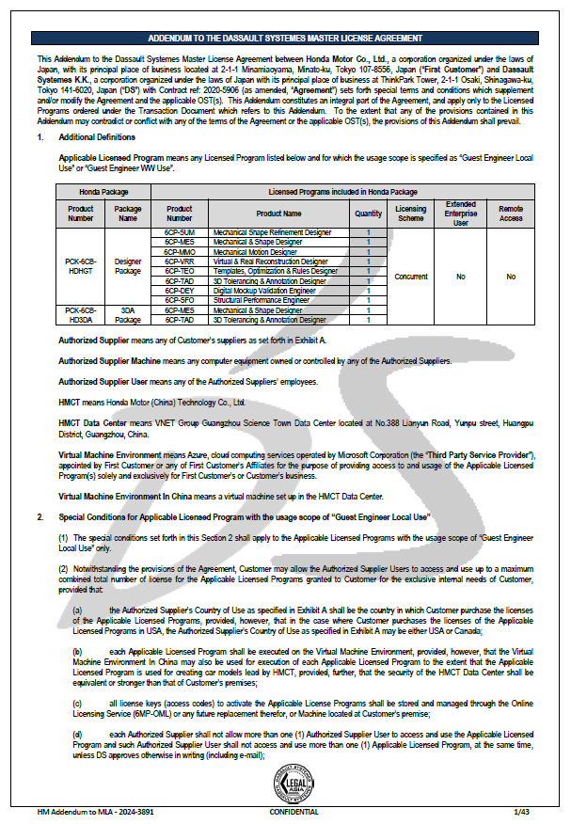
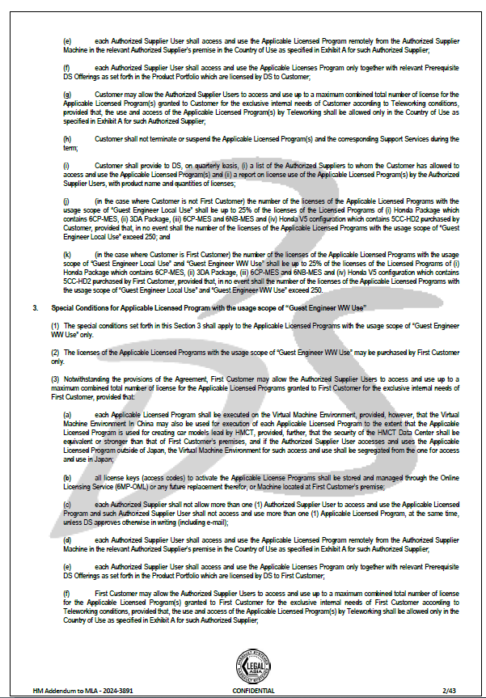
License scheme – Special terms appendix
HONDA Master CLOSA -Japan-V12.1-2020-5906 HM Addendum to MLA - 2024-3891 has to be used, Refer chapter2 Special Conditions for Applicable Licensed Program with the usage scope of “Guest Engineer Local Use”.
Confidential - DS Internal Information Sharing Purpose ONLY

Slide 16
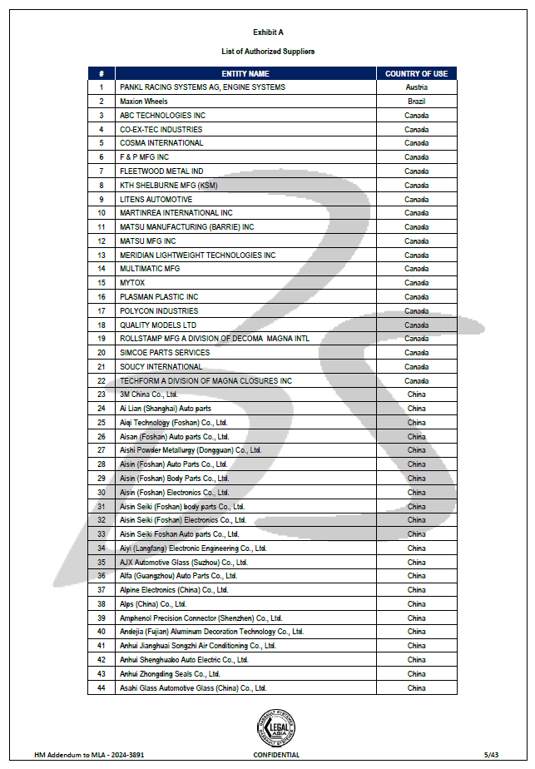
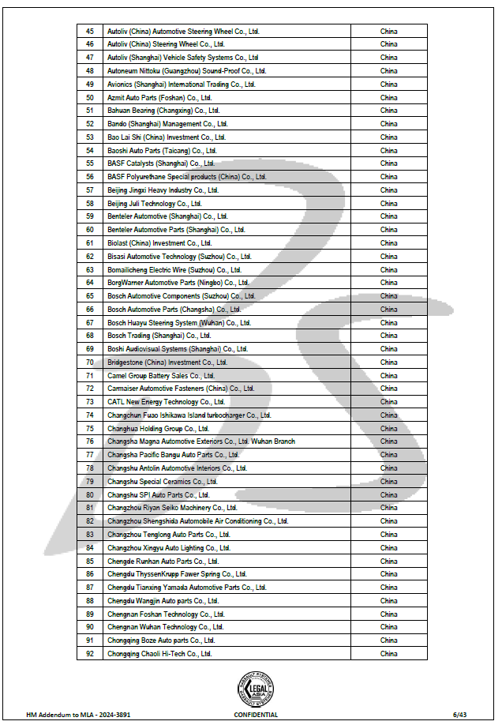
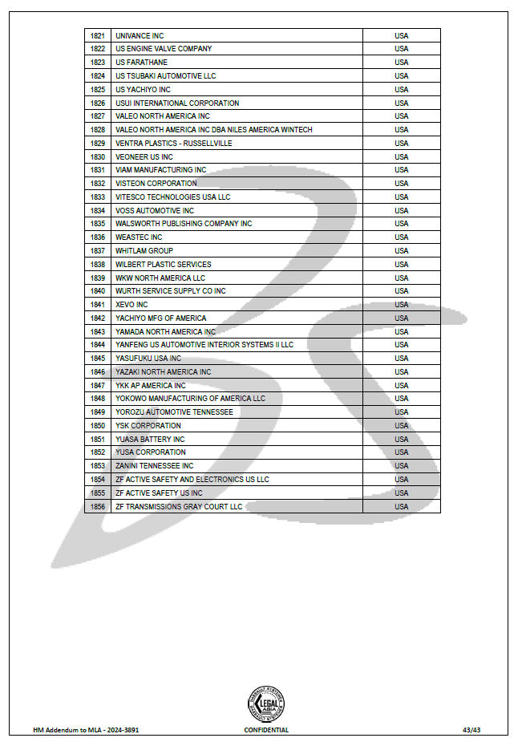
Authorized supplier for guest engineer license
Only authorized supplier employee can use this Honda guest engineer license.
Authorized supplier is listed in HONDA Master CLOSA -Japan-V12.1-2020-5906 HM Addendum to MLA - 2024-3891, Appendix A.
…1,856 suppliers as of July 2024
Confidential - DS Internal Information Sharing Purpose ONLY

Slide 17
SBO Process
Local Honda can purchase ONLY license for guest engineer
Honda
(local)
Contact local DS
Check!
Local DS
Check license amount
Accumulated Guest Engineer license amount is limited Max 25% of IB, Max 250.
Less 25% , less 250
SBO process
Refer to Frame IOC #IOC003937
Amendment : HONDA Master CLOSA -Japan-V12.1-2020-5906 HM Addendum to MLA - 2024-3891
Approved
PO create from SBO
Confidential - DS Internal Information Sharing Purpose ONLY

Slide 18
4. FAQ
Confidential - DS Internal Information Sharing Purpose ONLY

Slide 19
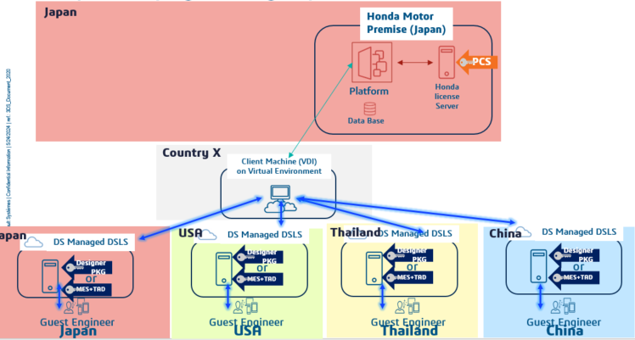
FAQ
[License offering]
Is it extend country usage if user in Vietnam access to MS Azure Japan environment ? (There is no Azure environment in Vietnam)
Licensee, user must be in same country wherever access to the assigned virtual Machine Environment.
 | Single country use
Licensee | Country A
DS License Server | Country A
User | Country A
Client Machine(VDI) | Assigned virtual machine environment
Single Country Use
Confidential - DS Internal Information Sharing Purpose ONLY

Slide 20
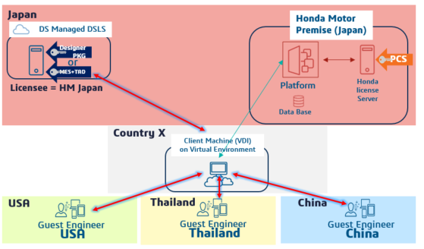
FAQ
[License offering]
If user in different country than licensee (local Honda) need to use Honda guest engineer license, what local Honda can do ?
Only HM Japan can purchase multi country use license for guest engineer. Local Honda needs to ask HM japan.
Multi Country Use
Confidential - DS Internal Information Sharing Purpose ONLY

Slide 21
FAQ
[License offering]
Can local Honda purchase guest engineer license more and more ?
the quantity of licenses accessed by Guest Engineers is limited to max 25% of IB* and max 250 lic;
*IB which contains MES, OEM PKG including MES and V5 configuration including HD2
e.g. MES* 50 , HD2 *30 = total 80 in IB => 80*0.25= 16 is available to purchase
Why guest engineer license is limited to purchase only 25% of IB and max 250?
In order to protect CPE supplier license business, IOC allowed only limited amount.
In case if supplier needs more license, supplier must purchase own license instead of requesting guest engineer license to Honda.
Confidential - DS Internal Information Sharing Purpose ONLY

Slide 22
FAQ
[License offering]
Can Honda provide many license for same supplier guest engineer ?
the quantity of licenses accessed by Guest Engineers is limited to max 1 per 1 supplier.
cannot exceed 1 unless DS approval with writing (including e-mail).
e.g. Honda may ask more than 1 guest engineer license for supplier A, because supplier A was nominated multi car programs and need guest engineer 1 per each car program.
Honda
(local)
Contact local DS
Sending e-mail to get DS approval for exceeding 1 guest engineer license for supplier X
Local DS
DS to acknowledge
Confidential - DS Internal Information Sharing Purpose ONLY

Slide 23
Team
Japan Team supporting HONDA supplier collaboration topics
Organization |  | Name | Trigram
JAPAN CSE -T&M2 (HONDA) | Senior Sales Director, HONDA GCE(Acting) & CPE | Naomi HERROD | UQT
 | Client Executive | Chihiro TANI | CTI3
HONDA Industry Consultants | HONDA Technical Senior Executive | Osamu AGAWA | OA2
JAPAN CPE | Partner Sales | Daisuke SUZUKI Misaki ARAI | MAI28
JAPAN Deal Value Engineering (DVE) | Senior Manager | Ayumu KAMIYAMA | AKA11
 | Specialist | Tomohiko SATO
Confidential - DS Internal Information Sharing Purpose ONLY

